Slide 1



DEFORESTATION
(Fire Classification)
Name : ARPIT RAJ KATIYAR
College: KANPUR INSTITUTE OF TECHNOLOGY
Std_ ID: STU67da5290608e11742361232
Internship ID : INTERNSHIP_1748923002683e727a876ea

Slide 2

Learning Objectives
Understand the Concept of Green Skills:
Grasp the importance of sustainable practices and environmental responsibility in modern industries.
Apply AI Technologies to Solve Real-World Problems:
Learn how artificial intelligence can be leveraged to address challenges related to the environment and sustainability.
Enhance Data Handling and Analysis Skills:
Gain hands-on experience in data pre-processing, visualization, and modeling using AI tools.
Develop and Evaluate Machine Learning Models:
Understand the process of model selection, training, evaluation, and optimization for impactful applications.
Collaborate in a Professional Learning Environment:
Engage in mentorship, group learning, and feedback cycles to simulate a professional work culture.
GOAL
Source :
www.freepik.com/

Slide 3
Tools and Technology used
Programming Language
Python – for data preprocessing, model building, and automation
Development Environment
Jupyter Notebook
Data Processing & Visualization Libraries
Pandas – for data manipulation and analysis
NumPy – for numerical operations
Matplotlib & Seaborn – for data visualization
Machine Learning Libraries
Scikit-learn – for building and evaluating ML models
TensorFlow / Keras (if used) – for deep learning tasks
XGBoost / LightGBM – for advanced model training (optional, based on your project)
Version Control
Git / GitHub – for version management and project collaboration
Presentation Tools
Microsoft PowerPoint / Google Slides – for project presentation and final showcase

Slide 4
Methodology
The project followed a systematic approach to develop a machine learning model for classifying forest fire occurrences using AI:
Problem Definition
Identified the issue of increasing deforestation due to wildfires.
Set the objective to classify fire-prone areas using historical and environmental data to enable early alerts and mitigation.
Data Collection
Collected relevant datasets containing forest attributes (e.g., temperature, humidity, wind, rain, vegetation index, fire intensity, etc.).
Datasets were sourced from open repositories or provided datasets.
Data Preprocessing
Cleaned the dataset by handling missing values, removing noise, and encoding categorical variables.
Normalized feature values to improve model performance.
Exploratory Data Analysis (EDA)
Visualized feature relationships using heatmaps, scatter plots, and histograms.
Analyzed patterns between environmental factors and fire occurrences.

Slide 5
Feature Selection
Identified the most influential features contributing to forest fire prediction using correlation analysis and feature importance metrics.
Model Building
Applied classification algorithms such as:
Logistic Regression
Decision Tree / Random Forest
Support Vector Machine (SVM)
Split the data into training and testing sets for model validation.
Model Evaluation
Evaluated performance using metrics like Accuracy, Precision, Recall, F1-Score, and Confusion Matrix.
Fine-tuned hyperparameters for better results.
Prototype Deployment
Created a simple user interface or interactive notebook for predicting fire classification based on user-input data.
Presentation and Documentation
Documented the entire methodology and outcomes.
Presented the project findings through a detailed PPT during mock and final evaluations.

Slide 6
Problem Statement:
This project aims to build an AI-based classification model that can accurately identify and predict the occurrence of forest fires using environmental and geographical data. The model will assist authorities and environmental agencies in taking proactive measures to protect forests and reduce ecological damage.

Slide 7
Solution:
To address the issue of uncontrolled forest fires leading to deforestation, this project proposes an AI-based classification system that can:
Analyze Environmental Data
Uses historical and real-time data such as temperature, humidity, wind speed, rainfall, and vegetation to assess fire risk.
Predict Fire-Prone Areas
Applies machine learning algorithms to classify areas as fire-prone or not fire-prone with high accuracy.
Enable Early Alerts
The system can assist forest departments and environmental agencies in identifying high-risk zones in advance.
Support Decision-Making
Provides insights to support quick, informed actions for fire prevention and forest resource management.
Build a Scalable and Cost-Effective Model
Offers a data-driven, automated, and scalable solution that can be implemented in various geographical regions with minimal manual intervention.

Slide 8
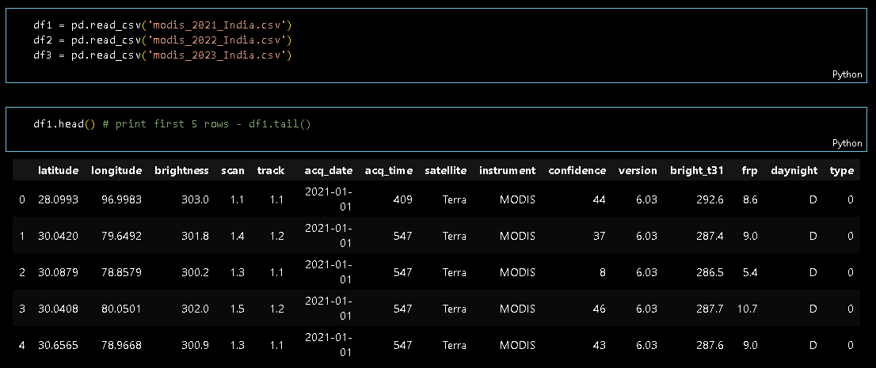
Screenshot of Output:

Slide 9
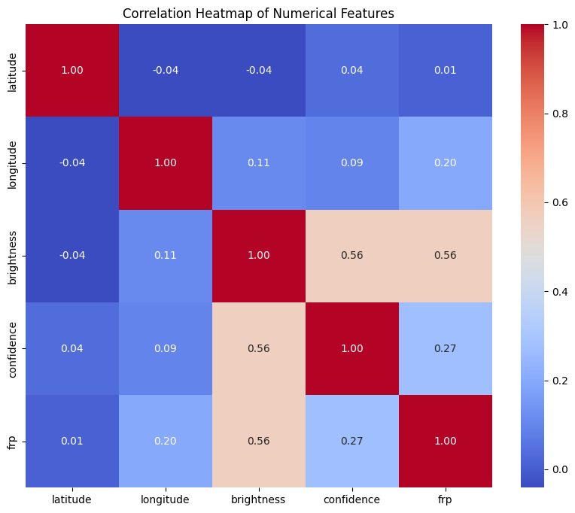
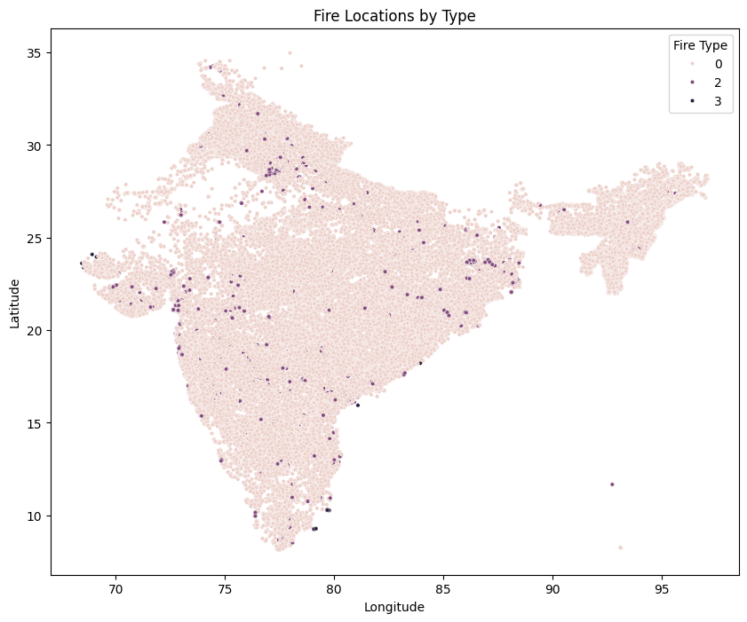
Screenshot of Output:

Slide 10
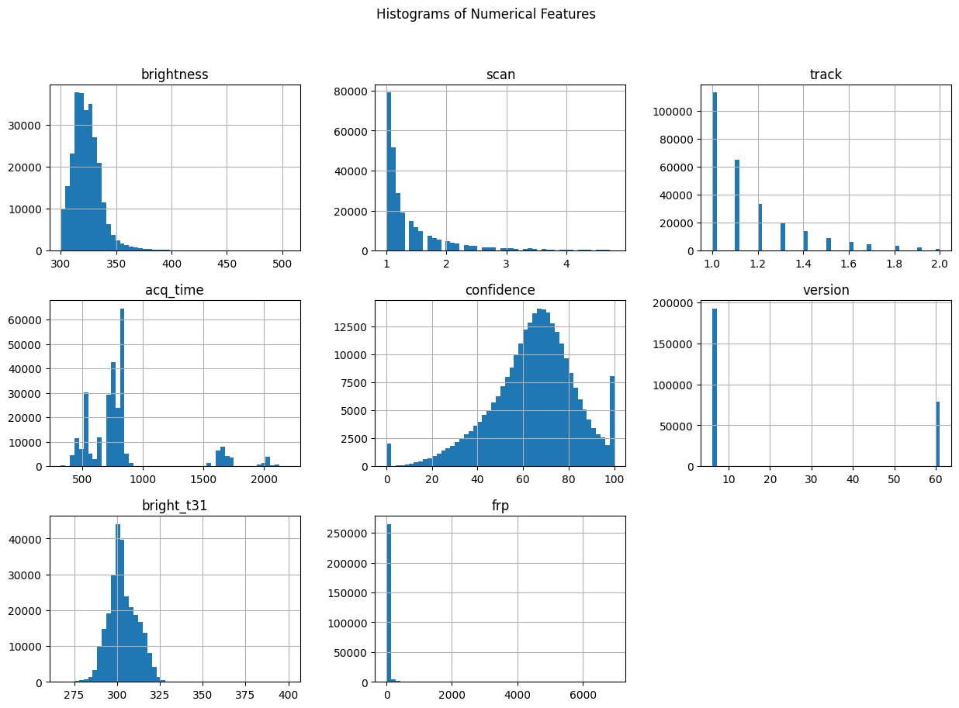
Screenshot of Output:

Slide 11
Conclusion:
The project successfully demonstrates the use of Artificial Intelligence in identifying and classifying forest fire-prone areas using environmental data.
By leveraging machine learning techniques, we were able to build a predictive model that can assist in early detection and prevention of forest fires. This can help minimize deforestation, reduce ecological damage, and support sustainable forest management.
The project highlights the potential of AI as a powerful tool for solving real-world environmental challenges and contributing to a greener, safer future.
Github Link : https://github.com/mrark1/Deforestation_Fire_classification
Source Code Link : https://github.com/mrark1/Deforestation_Fire_classification/blob/main/main.ipynb

Slide 12
THANK YOU

